Slide 1
RISK GAME - BUILD 2 IMPLEMENTATION TEAM 25

Slide 2
Risk Game - What is it ?
RISK
Is a strategic board game played against 2 to 6 players. The main aim is to attack and conquer the neighboring territories.
The winner is declared when a player conquers all the territories in the map.
Rules focused on for this Build
Conquer all to win.
Always a connected graph.
Attack only adjacent territories.
Provide armies at the start of every turn based on holding cards, territories and continents owned.
‘N’ Number of attack moves.
Move armies once to fortify.

Slide 3
Introduction
1
~To The Build Requirements

Slide 4
Functional Requirements:
Gameplay – Phase View Observer and Domination Observer.
Reinforcement Phase – Card Exchange View. .
Attack Phase – Player Model.

Slide 5
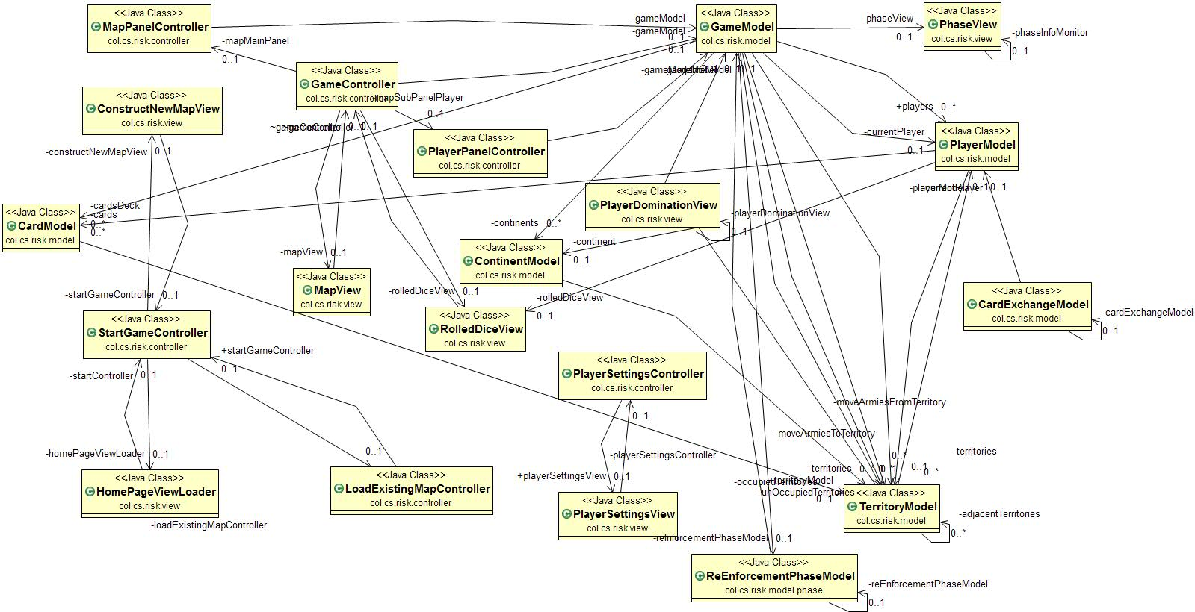
Proposed Architecture

Slide 6
Proposed Solution
Based on each requirement, we will display the code and demo in a proper and elegant manner.

Slide 7
Game Play– Phase View and Domination
The Phase view provides the details such as Name of the Phase, The current player and the information about the actions.
The domination observer view provides the percentage of nap controller, territories and continents owned and the total number of armies owned.

Slide 8
RISK Build1
A DEMO of Map Editor.

Slide 9
Attack Phase
User can select an territory to attack.
Respective number of armies are deducted accordingly.
An ‘All Out’ attack is implemented.
Number of Dice Rolled is also selected.
If an attack is not possible, end the turn.

Slide 10
RISK Build1
A DEMO of Startup Phase.

Slide 11
Reinforcement Phase
Provides armies according to the territories owned and the CARDS owned.
In this build, the Card Model has been implemented.
Here, the cards are assigned after every successful attack. (One Per Turn).
The User is given the choice of exchanging them for armies or is forced upon if he/she owns 5 or above.

Slide 12
RISK Build1
A DEMO of Reinforcement Phase.

Slide 13
Thanks!
Any questions?

Slide 14
References
https://tallyfy.com/uml-diagram/
http://www.extremeprogramming.org/
https://users.encs.concordia.ca/~paquet/wiki/index.php?title=SOEN6441_-_fall_2018

